Slide 1
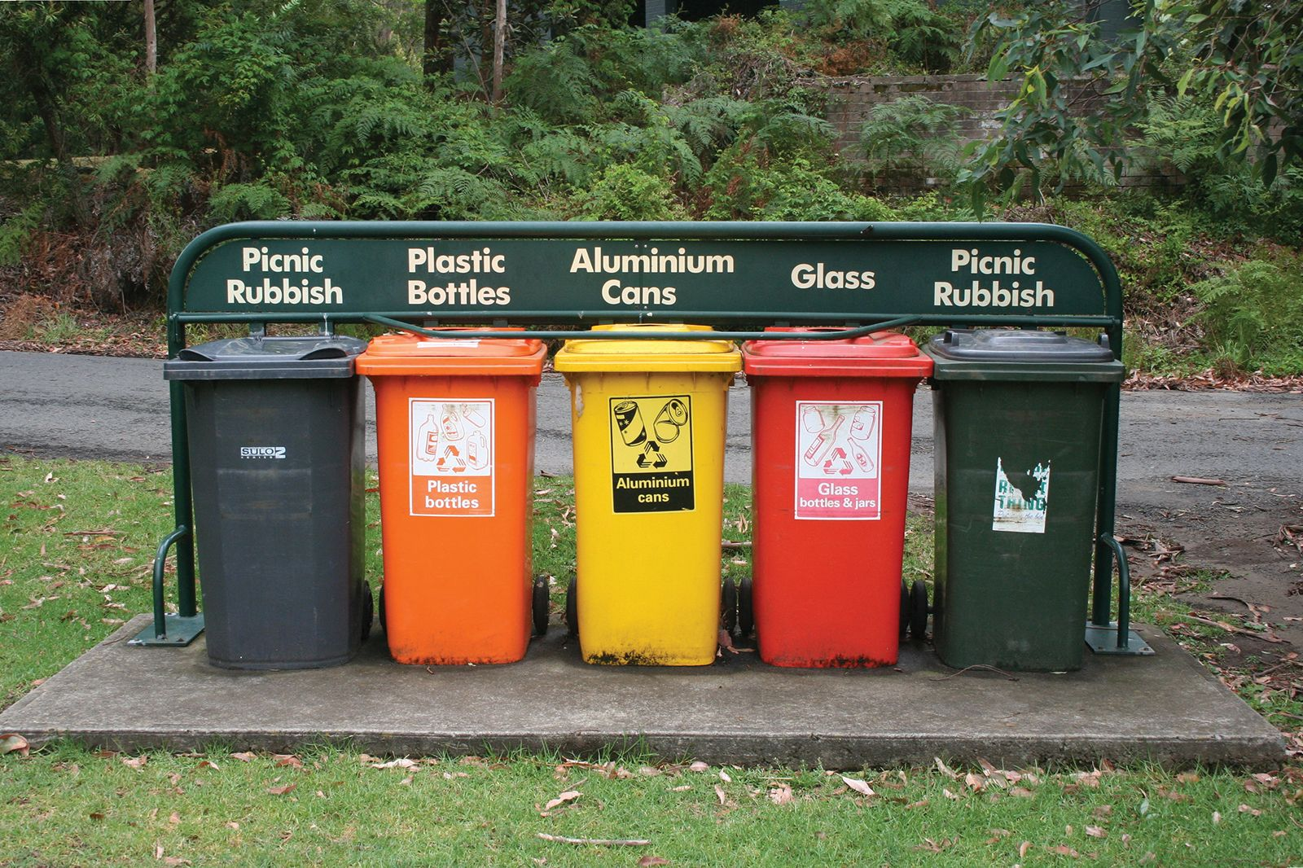
Garbage classification

Slide 2

Where is the data from?
https://www.kaggle.com/datasets/asdasdasasdas/garbage-classification
The Garbage Classification Dataset contains images categorized into six classes:
Cardboard: 393 images
Glass: 491 images
Metal: 400 images
Paper: 584 images
Plastic: 472 images
Trash: 127 images
Lets take a look at the images!

Slide 3
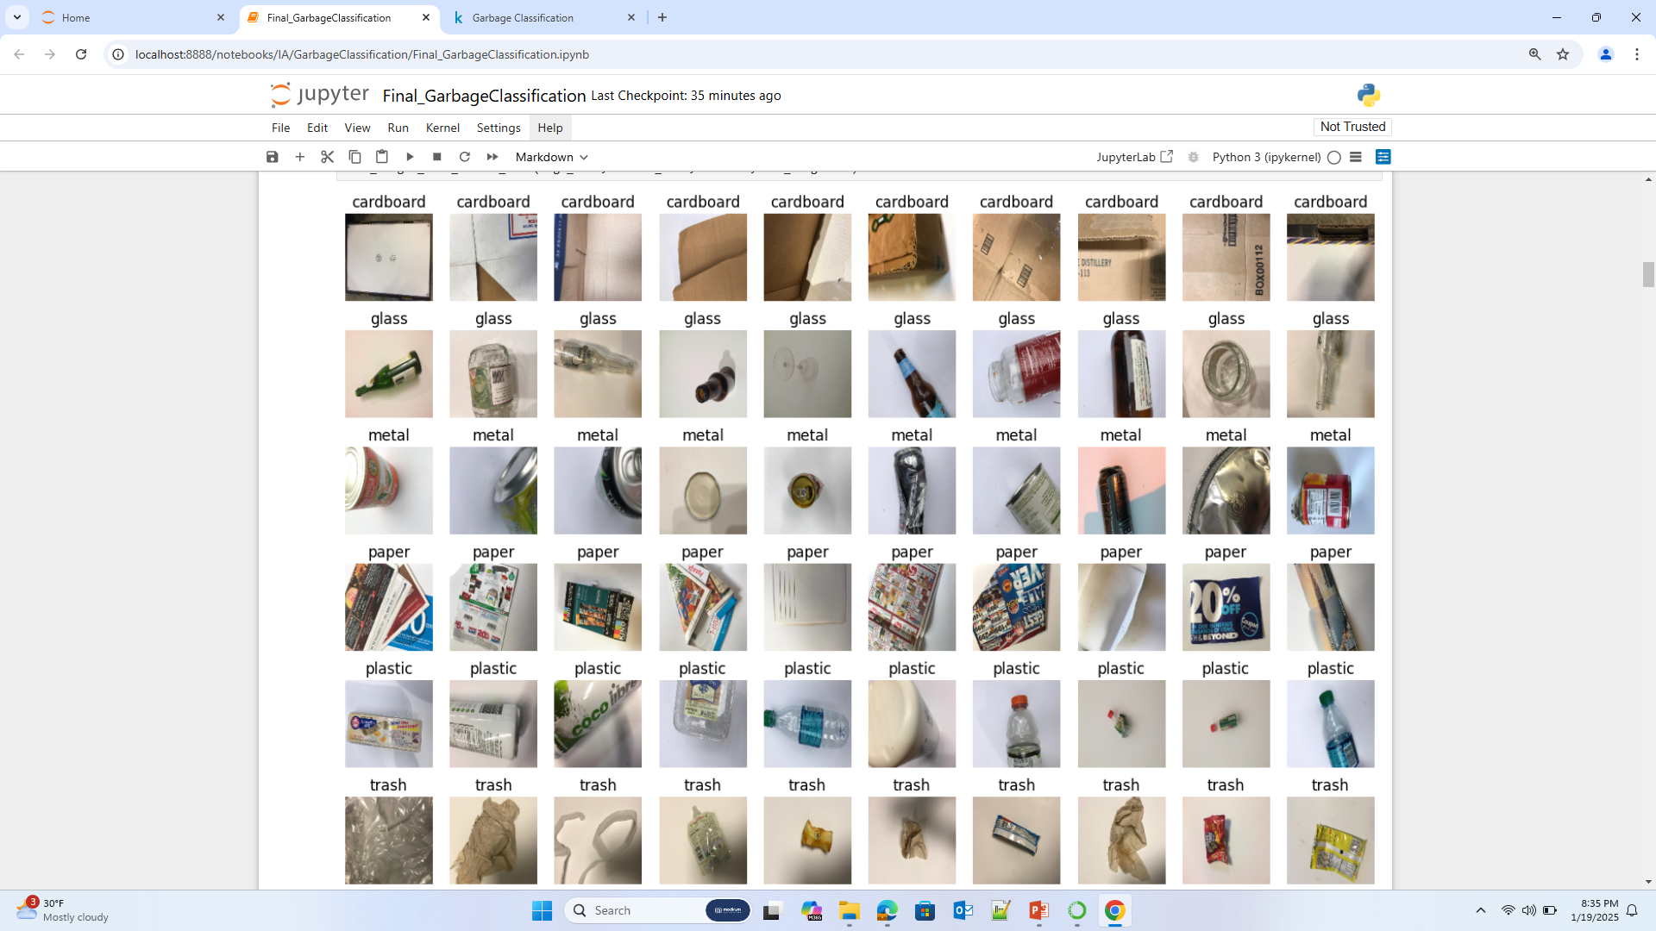

Slide 4
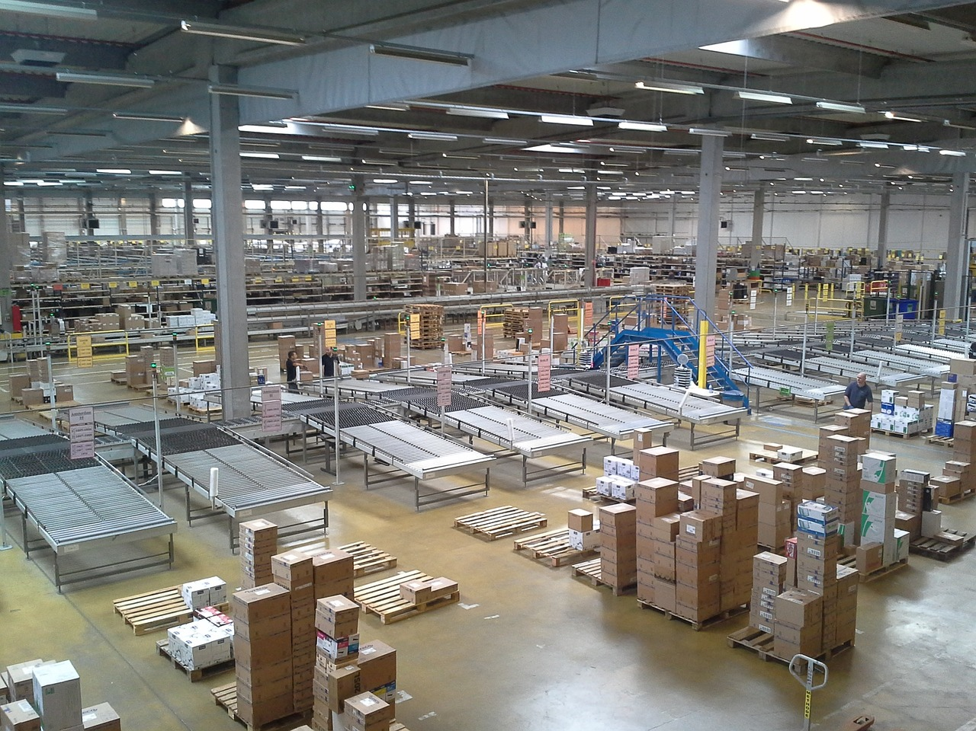
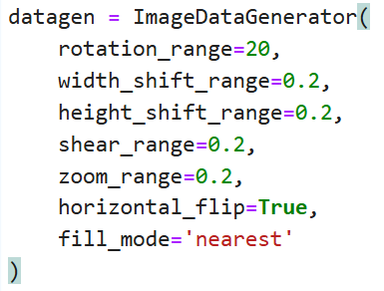
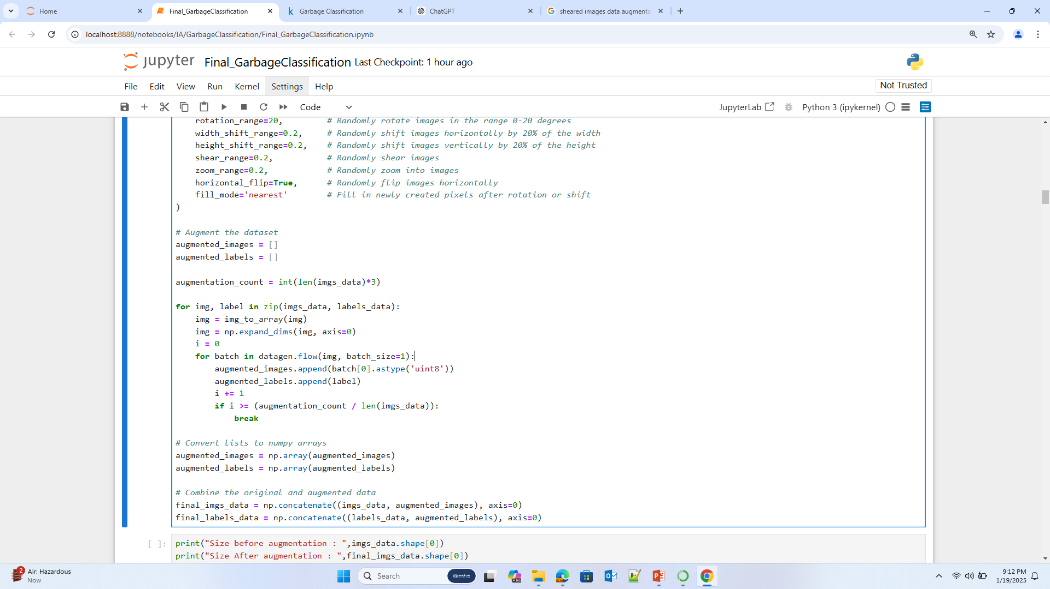




Data Augmentation
Properties
Rotation
Width shift
Height shift
Shear
Zoom
Horizontal flip
Fill
2527 10108
How to fill the empty pixels ?

Slide 5
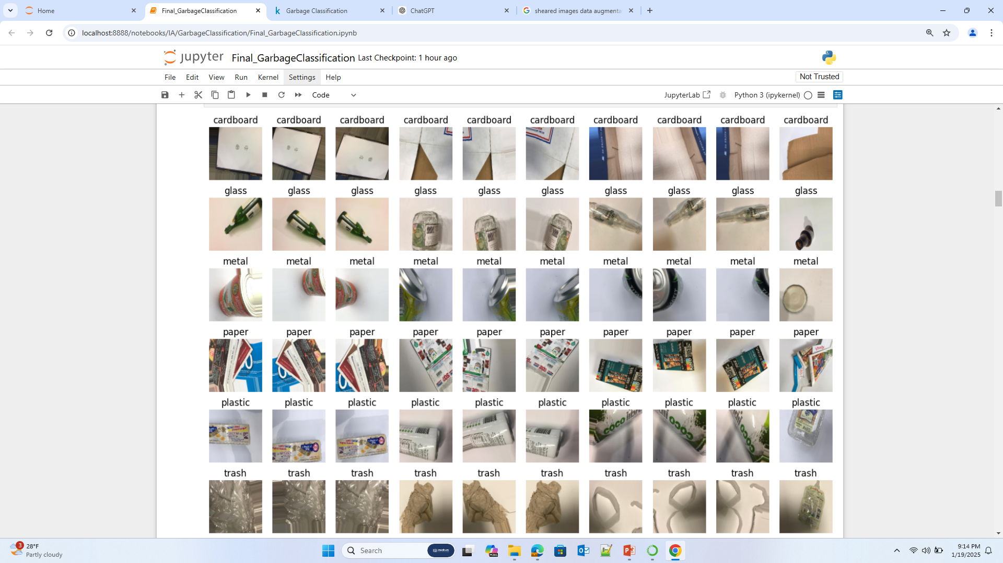

Slide 6

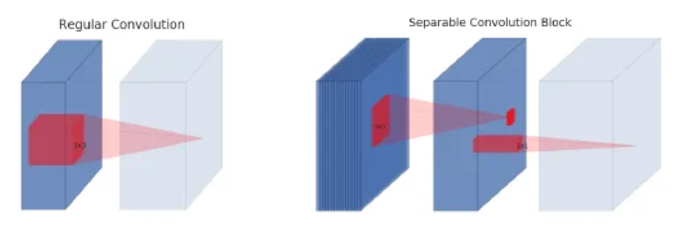
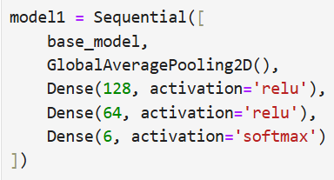
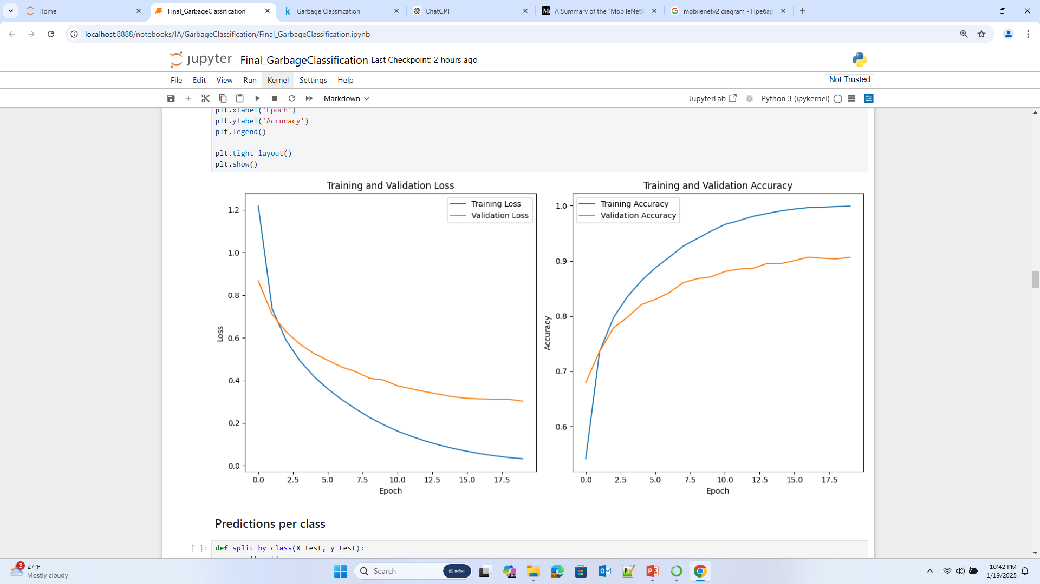
First model: Transfer Learning with MobileNetV2
MobileNetV2 is a model, made by Google Engineers and its purpose is to give excellent efficiency to performance ratio. It is meant for devices with less computational power. This is done by using separable convolutions. It consists of two steps: depth wise convolution (which operates on each input channel separately) and pointwise convolution (which combines the outputs from the depth wise step).
The base_model is a completely frozen MobileNetV2 convolutional base.
Test Accuracy:
0.8877348899841309

Slide 7
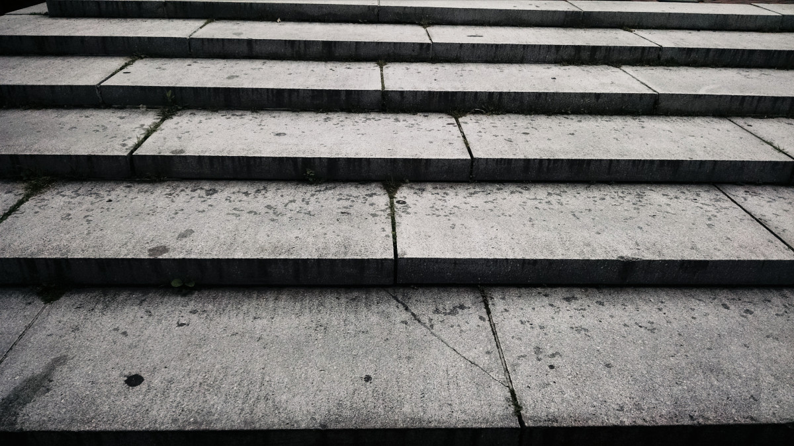
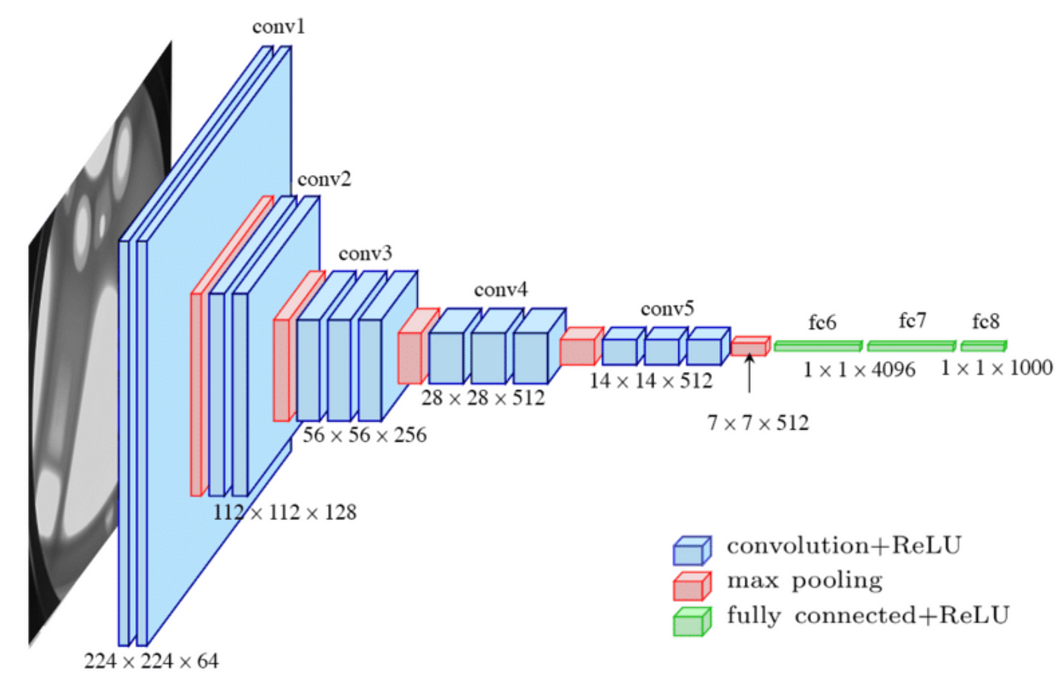
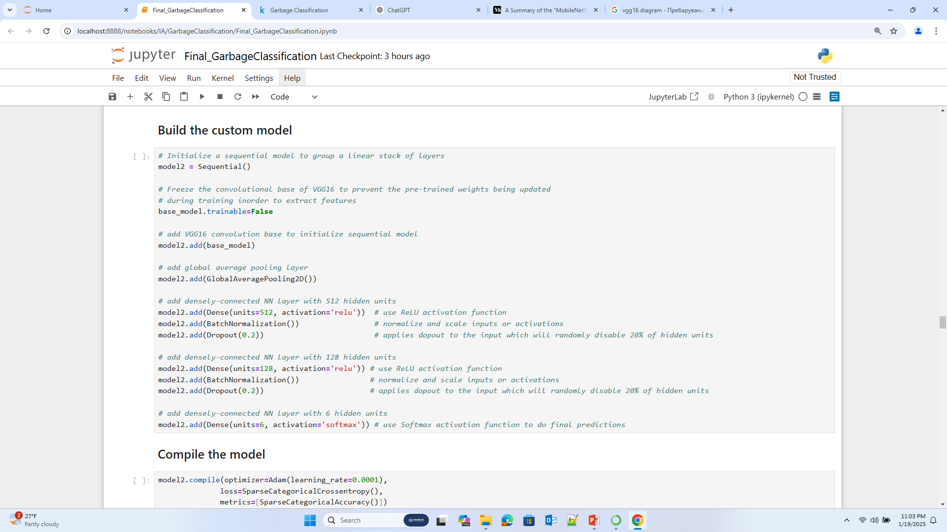
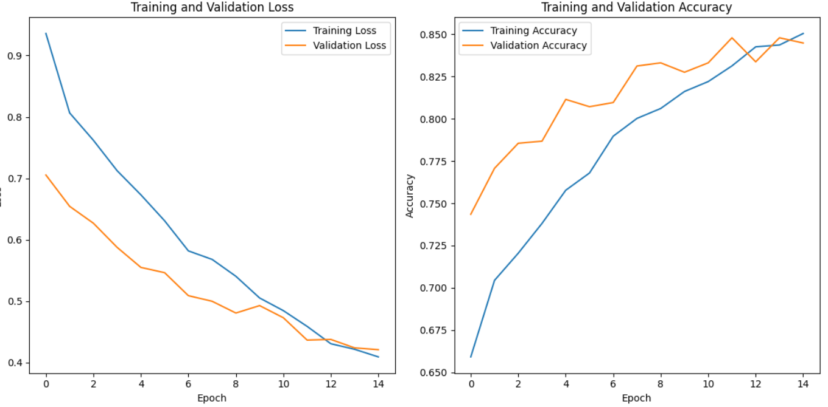
Second model: Transfer Learning with VGG16
In contrast, VGG16 was created with 16 neural layers to explore the effect of deep architectures on performance and to push the limits of what was possible. Its design is simple, but very repetitive thus very computationally expensive.
Test accuracy:
0.8412463068962097

Slide 8



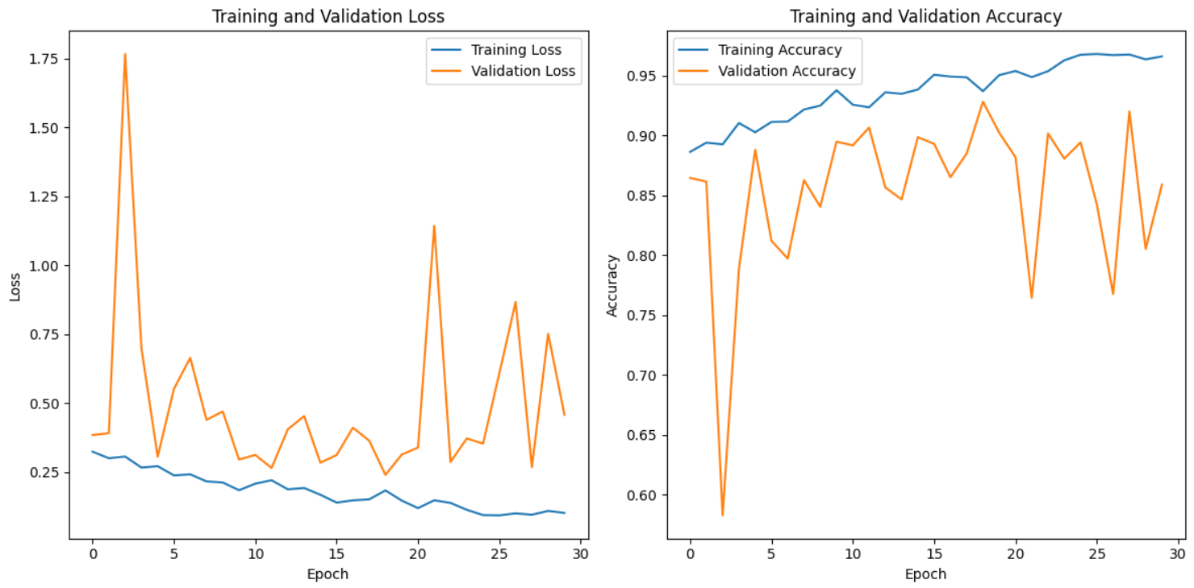
Third model: CNN
model1 = tf.keras.Sequential([
tf.keras.layers.Conv2D(32, (3, 3), activation='relu', input_shape=(128, 128, 3)),
tf.keras.layers.BatchNormalization(),
tf.keras.layers.Conv2D(32, (3, 3), activation='relu'),
tf.keras.layers.BatchNormalization(),
tf.keras.layers.MaxPooling2D(2, 2),
tf.keras.layers.Dropout(0.2),
tf.keras.layers.Conv2D(64, (3, 3), activation='relu'),
tf.keras.layers.BatchNormalization(),
tf.keras.layers.Conv2D(64, (3, 3), activation='relu'),
tf.keras.layers.BatchNormalization(),
tf.keras.layers.MaxPooling2D(2, 2),
tf.keras.layers.Dropout(0.2),
tf.keras.layers.Conv2D(128, (3, 3), activation='relu'),
tf.keras.layers.BatchNormalization(),
tf.keras.layers.Conv2D(128, (3, 3), activation='relu'),
tf.keras.layers.BatchNormalization(),
tf.keras.layers.MaxPooling2D(2, 2),
tf.keras.layers.Dropout(0.2),
tf.keras.layers.Conv2D(256, (3, 3), activation='relu'),
tf.keras.layers.BatchNormalization(),
tf.keras.layers.Conv2D(256, (3, 3), activation='relu'),
tf.keras.layers.BatchNormalization(),
tf.keras.layers.MaxPooling2D(2, 2),
tf.keras.layers.Dropout(0.2),
GlobalAveragePooling2D(),
tf.keras.layers.Dense(512, activation='relu'),
tf.keras.layers.BatchNormalization(),
tf.keras.layers.Dropout(0.4),
tf.keras.layers.Dense(6, activation='softmax')
])
Convolutional Neural Networks (CNNs) are a type of deep learning model designed for tasks involving image and visual data. They work by applying convolutional filters to extract features like edges, patterns, and textures, enabling the network to understand spatial hierarchies. CNNs are widely used for applications like image recognition, object detection, and segmentation due to their ability to efficiently learn complex patterns in data.
Early stopping
Test accuracy:
0.8550939559936523

Slide 9



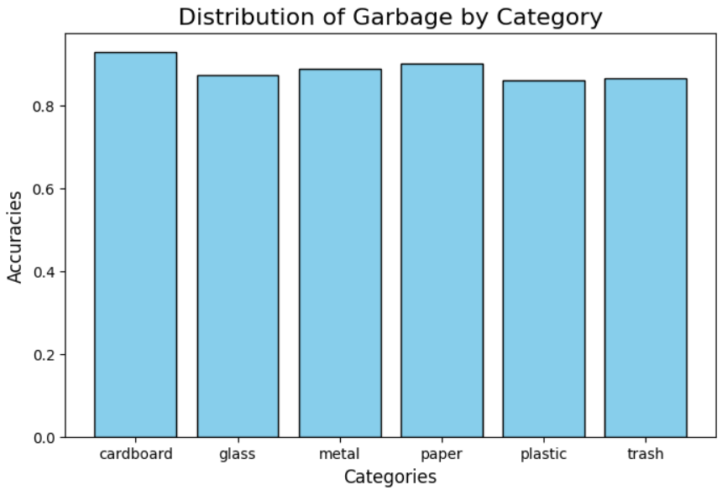
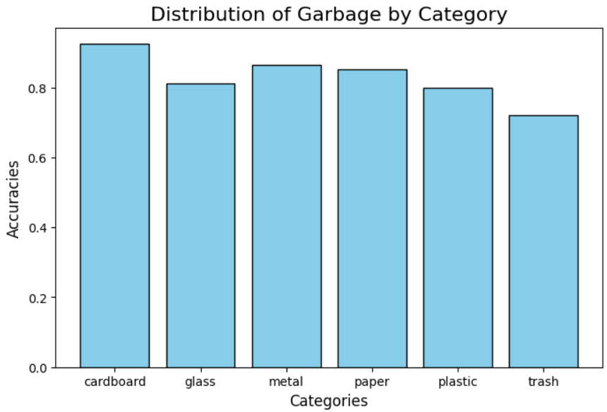
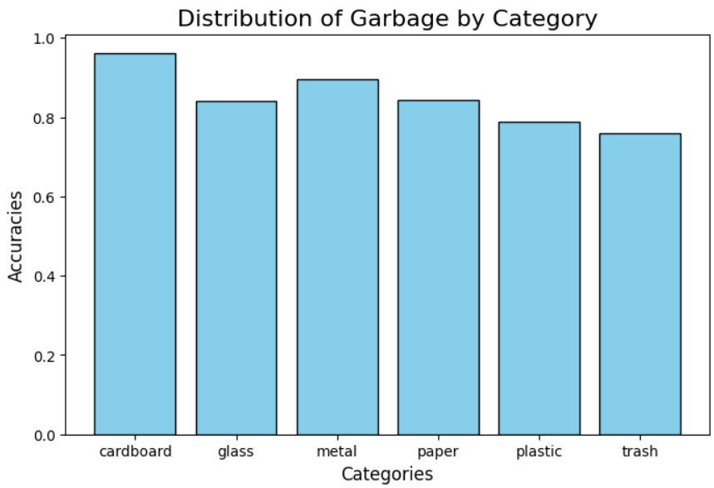
Which class was classified the best?
Highest accuracy in every model was achieved on the cardboard images. Probably because of the color.
As we expected, the remaining garbage that was labeled as “trash” was the hardest to classify. The images were very different from each other, making learning exceptionally hard.
Transfer Learning with MobileNetV2 Transfer Learning with VGG16 CNN

Slide 10
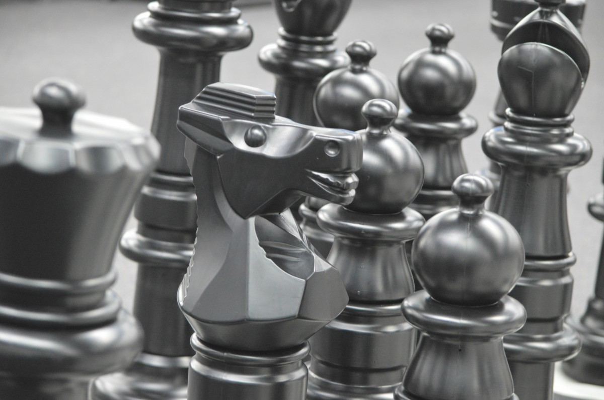

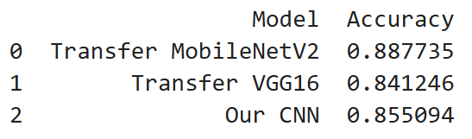
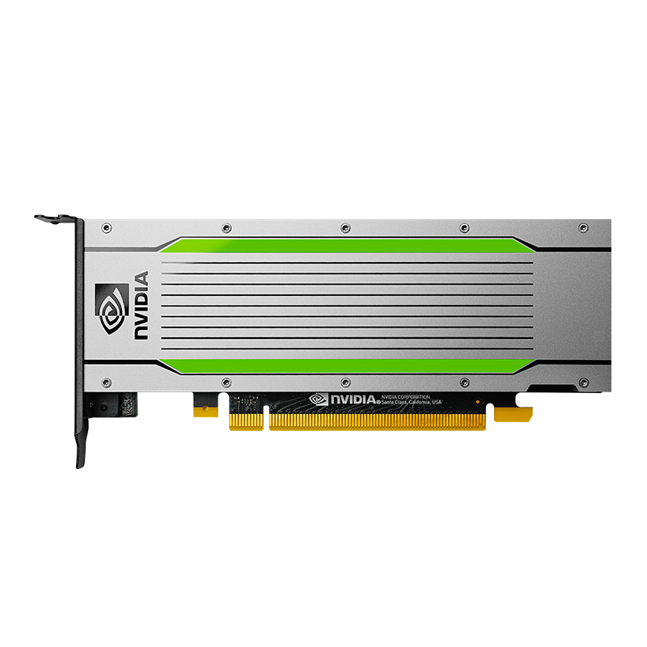

The best model so far
We expected that transfer learning would bring much better results than our own CNN. The reason was that these models are trained on huge amounts of data (like ImageNet), while on the other hand our dataset had 2527 images, which is considered as a small dataset, meaning the transfer learning was the better choice.
BUT, our own CNN surprised us. Although the transfer learning model did a better job, the CNN was close. Still, we think that transfer learning was more worth it because of the computational resources that it took.

Slide 11
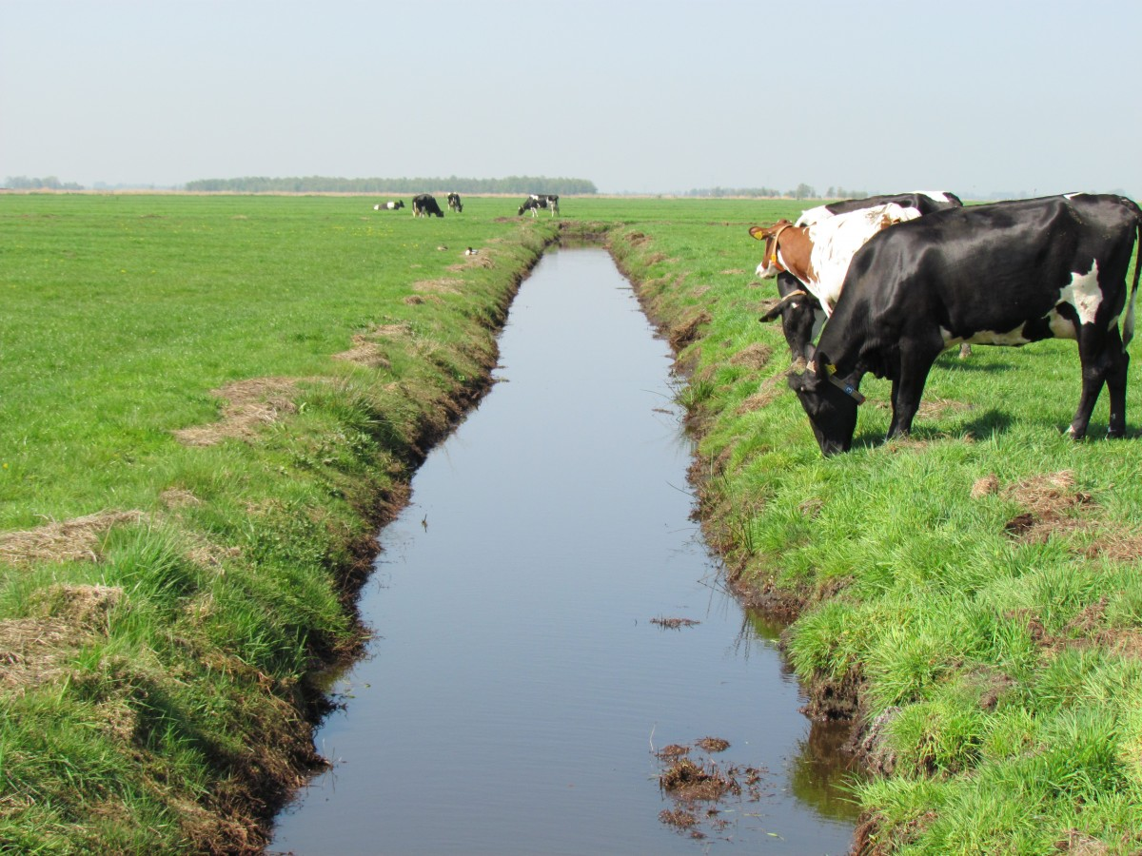
Where can this be used?
These type of models can be used in:
- Recycling centers: Automatically sorting recyclable materials like paper, glass, metal, and plastic.
- Smart waste management systems: Implementing AI-powered garbage bins that classify waste in real time.

